Slide 1
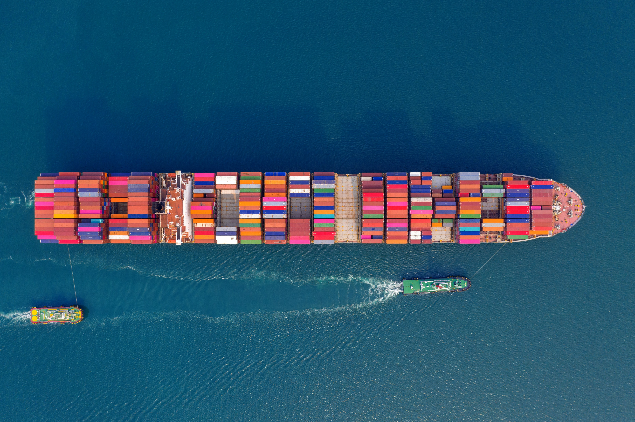
Analytic Computing
Fachpraktikum
Marine anomalies detection
08.02.2023
Qiuming Li
Zhenhao Xu

Slide 2
Contents
1. Motivation
2. Basic information
3. Features selection
5. Data generation
6. Date Preprocessing
7. Train and Test data
8. Model structure
9. Optimization of model and dataset
10. Comparing the performance of different models
11. Real accident test
12. Ideas for improvement

Slide 3
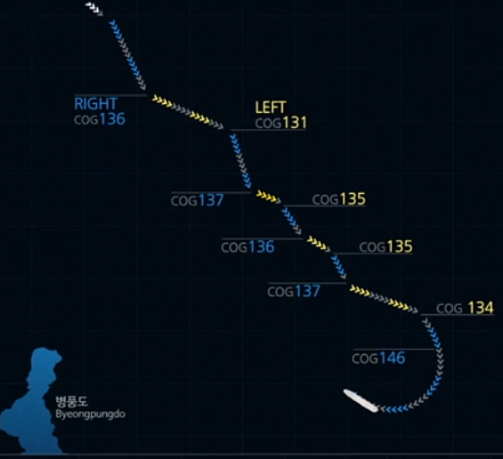
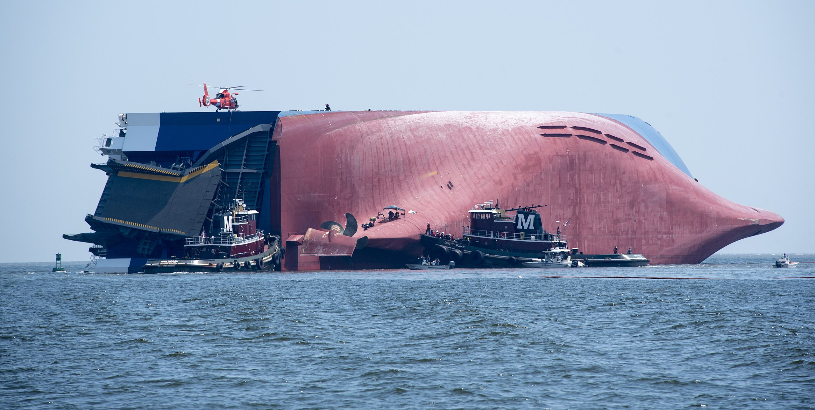
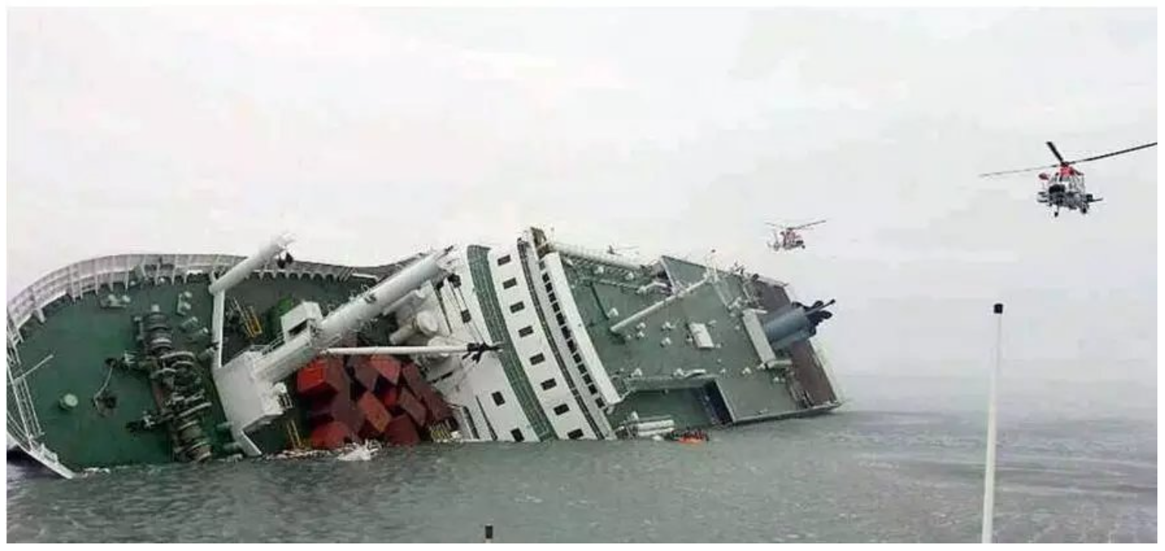
1. Motivation
MV Golden Ray capsized on 08.09.2019 within the Port of Brunswick's harbor
The ferry MV Sewol sank on the morning of April 16, 2014, an route from Incheon towards Jeju in South Korea, 306 died in the disaster, including around 250 students.
The automatic detection of abnormal behaviour of vessels in ports and sensitive waters and the implementation of early warnings are of great importance in ensuring water traffic safety.

Slide 4
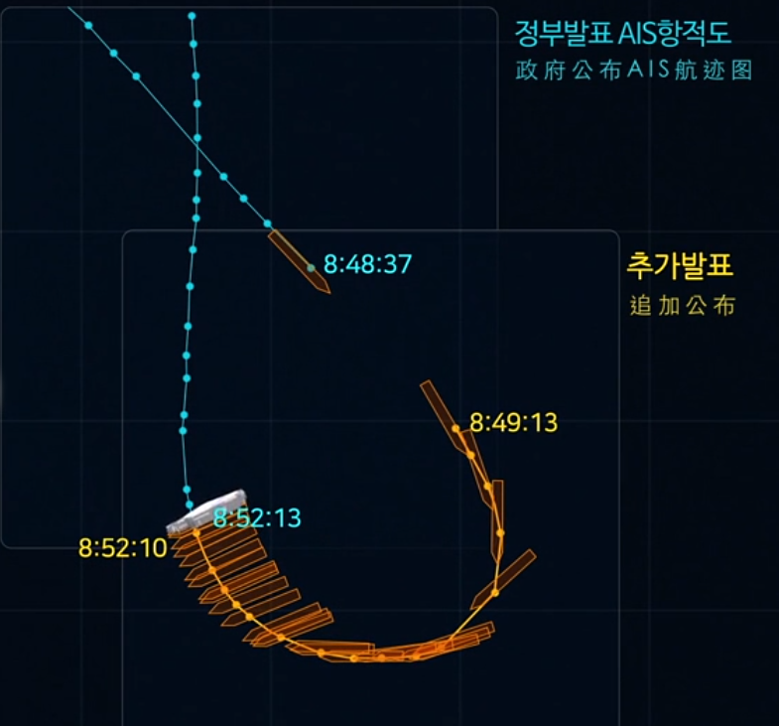
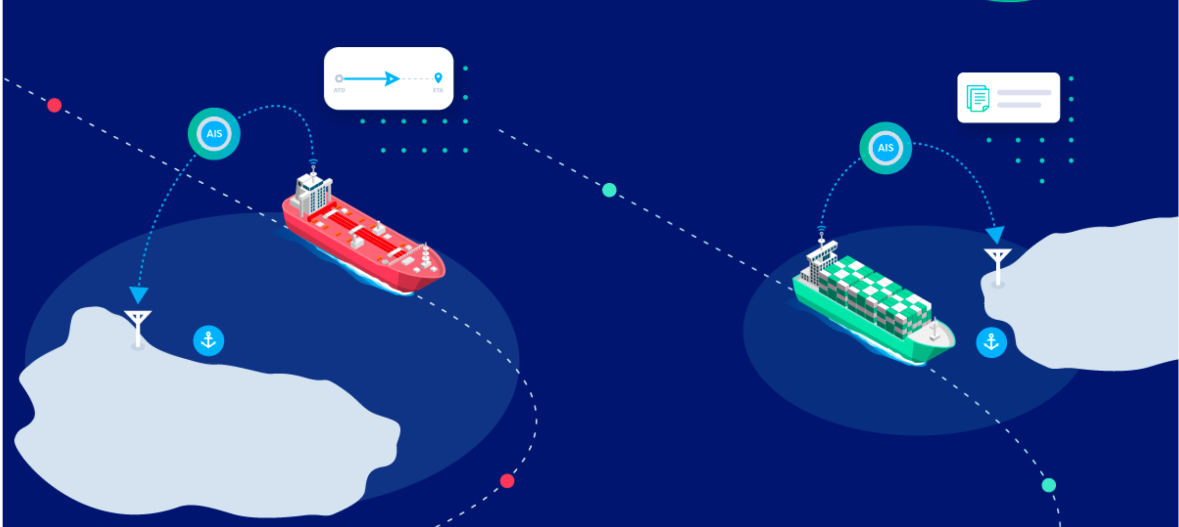
2. Basic information
AIS: Automatic Identification System
MMSI | BaseDateTime | LAT | LON | SOG | COG
367369550 | 2019-09-08T00:00:06 | 31.14314 | -81.49662 | 12.3 | 122.8
AIS is an automated, autonomous tracking system that tracks the location of vessels anywhere they are in the world.
MMSI: Maritime Mobile Service Identity, LAT/LON: latitude/longitude
SOG: Speed over Ground, COG: Course over Ground

Slide 5
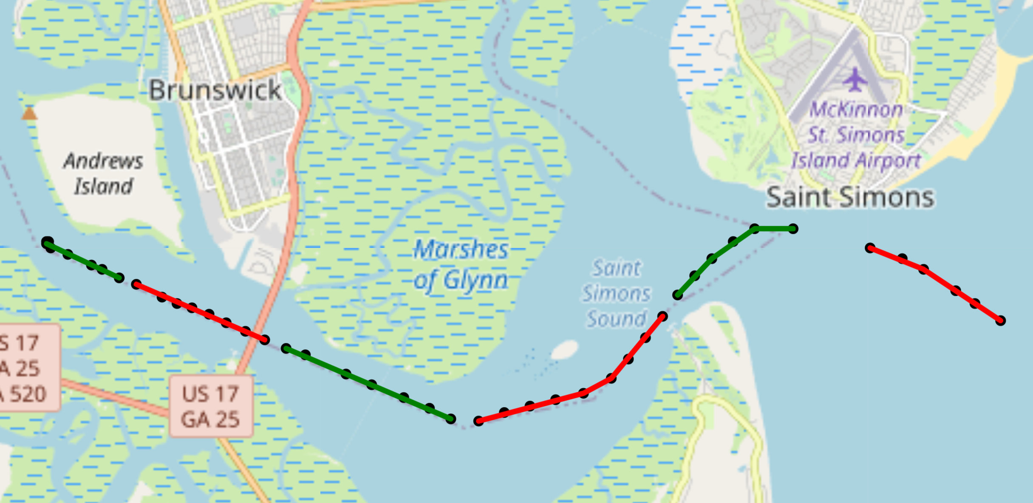
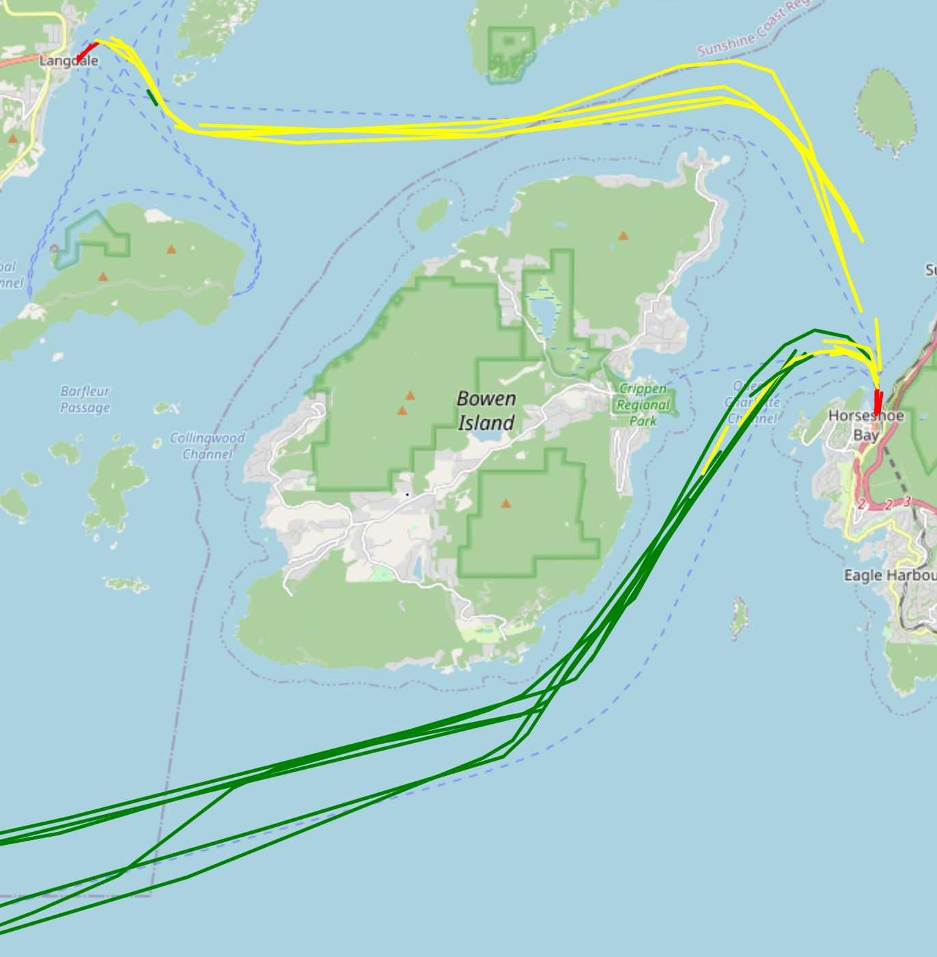
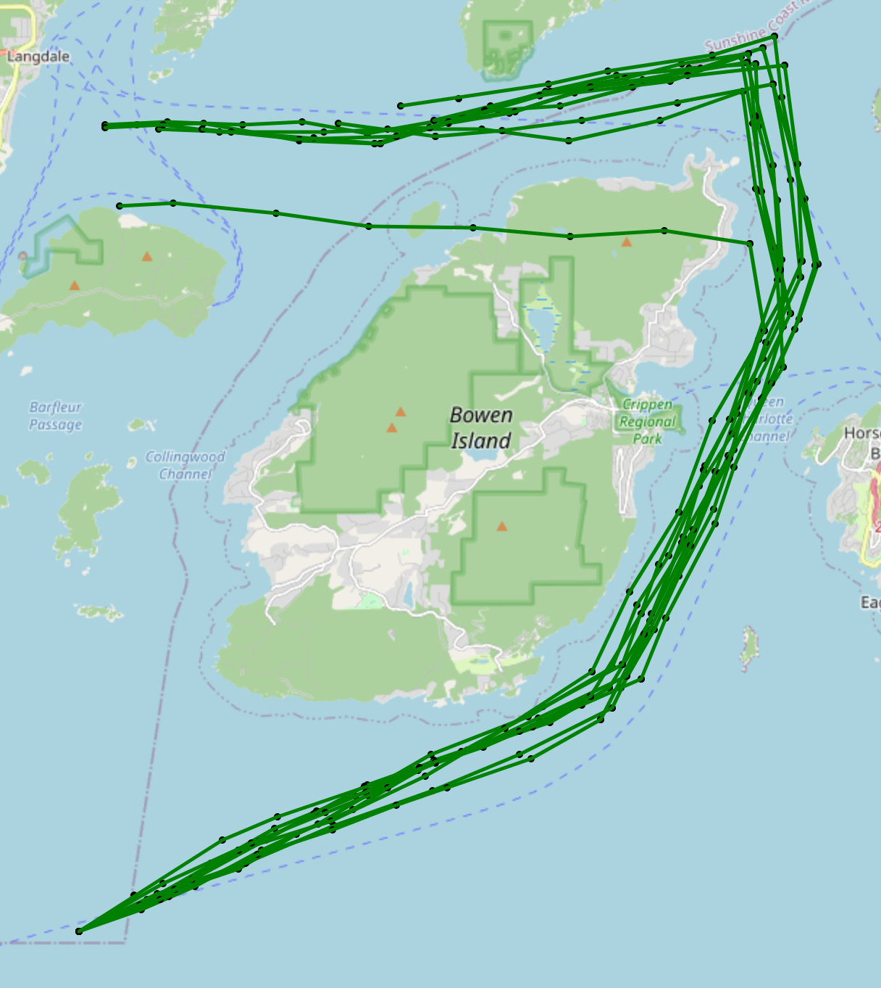
3. Basic Ideal
3.1 How is the data unit, which we want to detect
3.2 Label for Supervised learning
Treat all segments of the real track as normal segments
The colour here is only to distinguish the segments
Set up abnormal scenarios and simulate abnormal data
(High frequency changes of speed and direction)
Treat all segments in the simulation track as anomalies
These are all AIS data points of one ship in 10 min(max. 10 data points), We think of it as a segment of the ship's trajectory and want to detect each segment for anomalies.
To do this, we use supervised learning to train the model, so we need to set labels for the dataset to distinguish between abnormal and normal data.

Slide 6
4. Features Selection
SOG: Speed over Ground
COG: Course over Ground
Distance: Calculate the distance between two points by using the latitude and longitude of the two adjacent points
Data
point2
COG
SOG
Diff latitude
Data
point1
Distance
Diff longitude
So we select 3 Features for each time points, and each segment have max. 10 time points.
We can use a 10x3 array to describe the entire segment

Slide 7
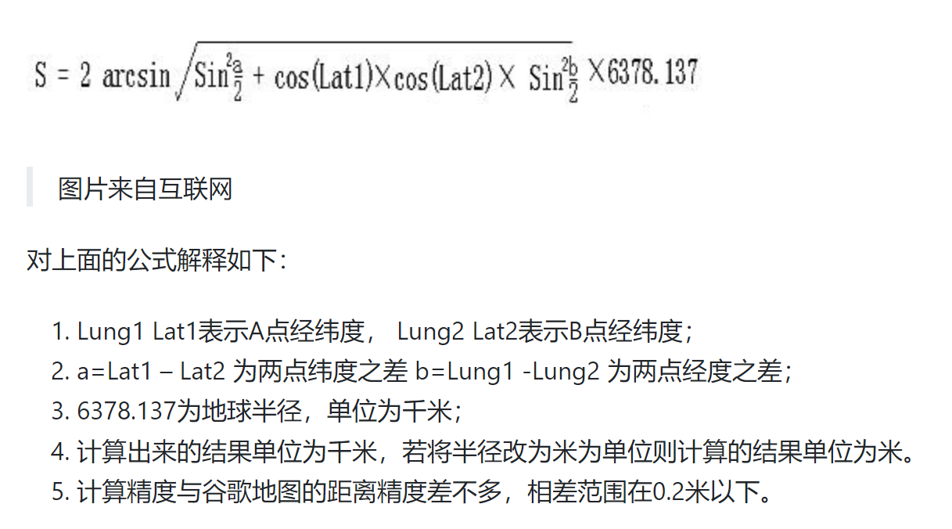

Slide 8
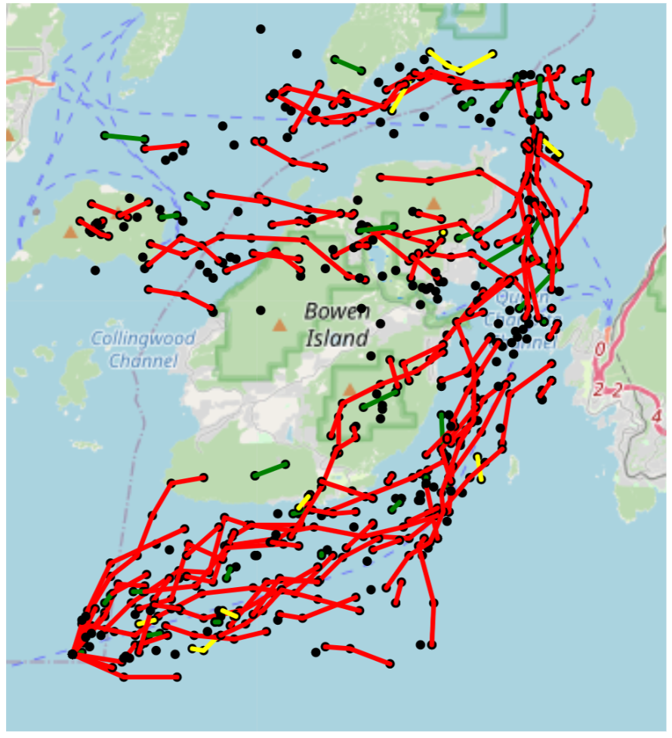
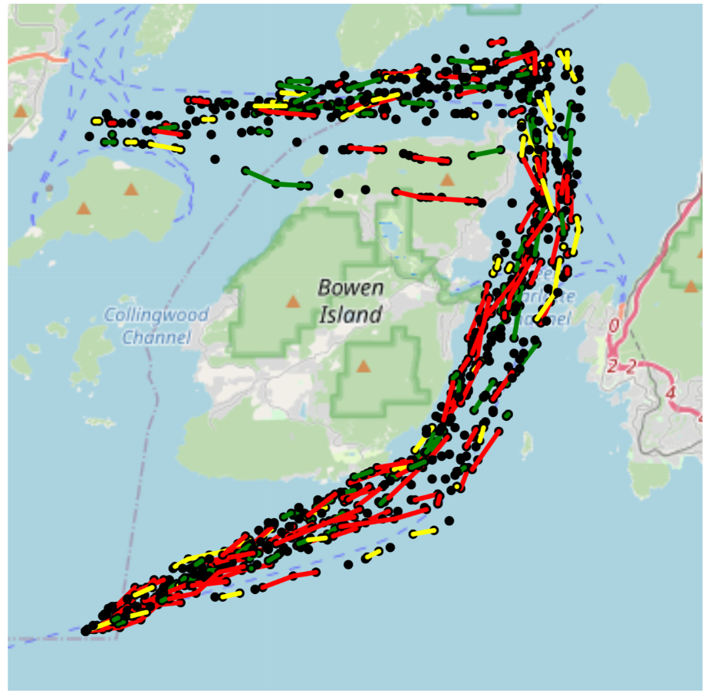
5. Data Generation

Slide 9
6. Data preprocessing
N times real Data Segments of each Ship in each 10 min. so its 10x3 2DArray
combined and be saved in 3D Array (N+M)x10x3
Model
Origin_real_Data
Select Region
real_Data_region_1
Segmentation
generation
M times Segment (5 ships) generated Data of each Ship in each 10 min. so its 10x3 2DArray
label for each Segment be saved in 2D Array (N+M)x2
Shape of Input data
2D Array (10x3) for each Segment
3D Array(number of Segments x 10 x 3) for whole input dataset
Shape of Output data
1D Array (2) for each Segment, normal or abnormal
2D Array(number of Segments x 2) for whole input dataset

Slide 10
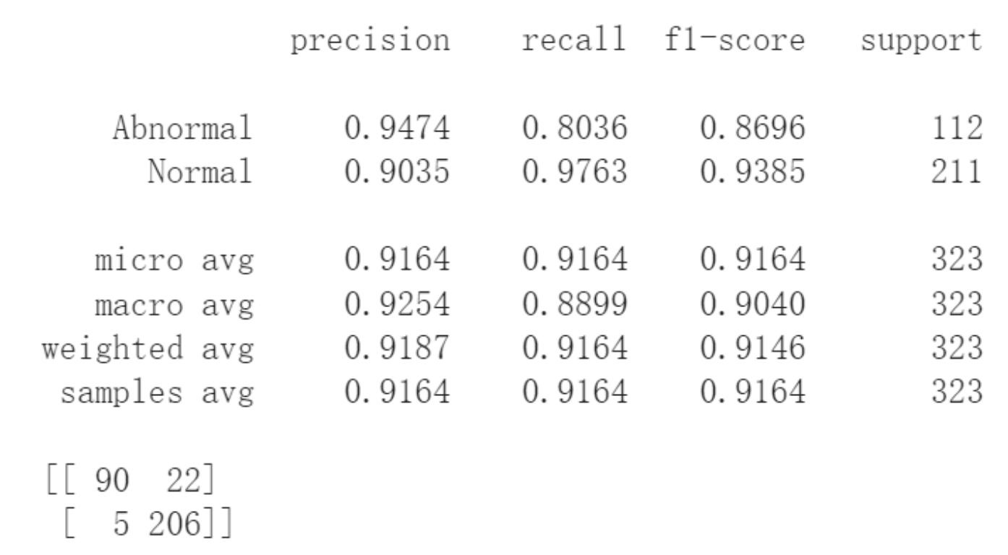
7. Train/Test Dataset and Evaluation
Train Dataset: 30 ships real data in 2019_01_01 as normal data in selected area
15 ships random generation data as abnormal data in selected area
Test Dataset: 30 ships real data in 2019_06_01 as normal data in selected area
15 ships random generation data as abnormal data in selected area
Dataset for real accident test:
20 ships real data in 2019_09_08 in the area the accident happens
20 ships real data in 2019_09_07 in the area the accident happens

Slide 11
8. Model structure 补充每层原理？
Input 10x3
convolution 1.st layer + BatchNormalization + Dropout, “relu”,outputshape:10x64
convolution 2nd layer + BatchNormalization + Dropout, “relu”, outputshape:10x128
Maxpooling, strides=1, outputshape:9x128
convolution 3rd layer + BatchNormalization + Dropout, “relu”, outputshape:9x256
Maxpooling, strides=1, outputshape:8x256
Flatten, outputshape:1x2048
Dense 1st layer + BatchNormalization + Dropout, “relu”, outputshape:1x64
Dense 2nd layer + BatchNormalization + Dropout, “relu”, outputshape:1x32
Dense 3rd layer + BatchNormalization + Dropout, “relu”, outputshape:1x16
Dense final layer , “softmax”, outputshape:1x2
Output 1x2

Slide 12
Model1
9. Optimization of models and datasets
1. use 2 features: SOG COG
Model2
1. use 3 features: Distance SOG COG
Dataset1 (Overfitting?)
1. if there are less than 10 time point in one segment, Supplement missing signals with 0
2. no missing data in generation dataset
Dataset2 (too little information?)
1. if there are less than 3 time point in one segment, drop it. otherwise supplement missing signals with 0
2. random missing data(at least 3 time point rest) in generation dataset, and supplement with 0
Dataset3 (the best)
1. if there are less than 5 time point in one segment, drop it. otherwise supplement missing signals with 0
2. random missing data(at least 5 time point rest) in generation dataset, and supplement with 0
Dataset4(just try)
1. All same as Dataset3 but the generation data seems like more unreal

Slide 13
10. Comparing the performance of different models
10.1 Statistics View of results（趋势标记）
 | Dataset_1 | Dataset_2 | Dataset_3
Model_1 | Result_1 | Result_3 | Result_5
Model_2 | Result_2 | Result_4 | Result_6

Slide 14
10. Comparing the performance of different models
10.1 Statistics View of results
 | Dataset_1 | Dataset_2 | Dataset_3 | Dataset_4
Model_1 | Result_1 | Result_3 | Result_5 | Result_7
Model_2 | Result_2 | Result_4 | Result_6 | Result_8

Slide 15
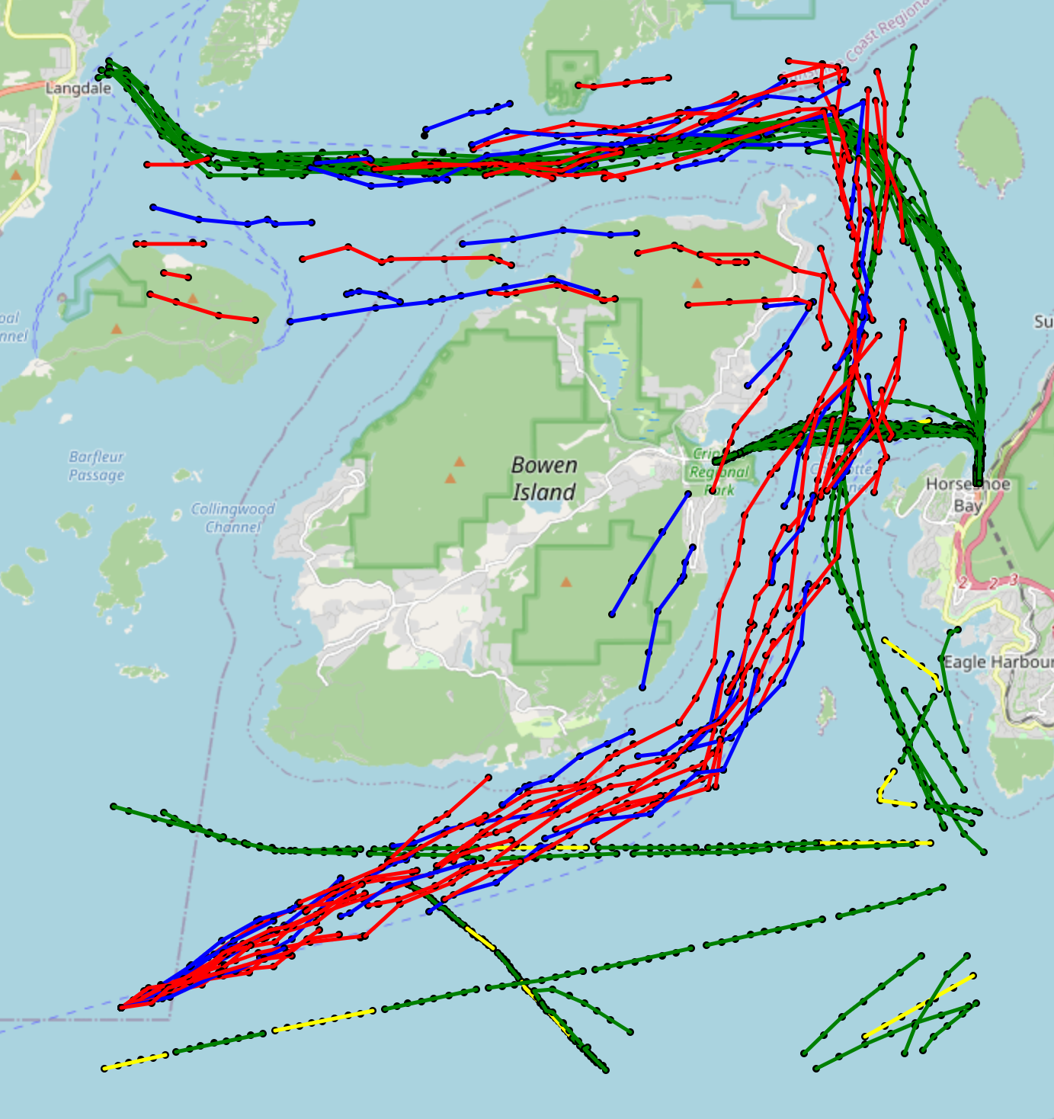
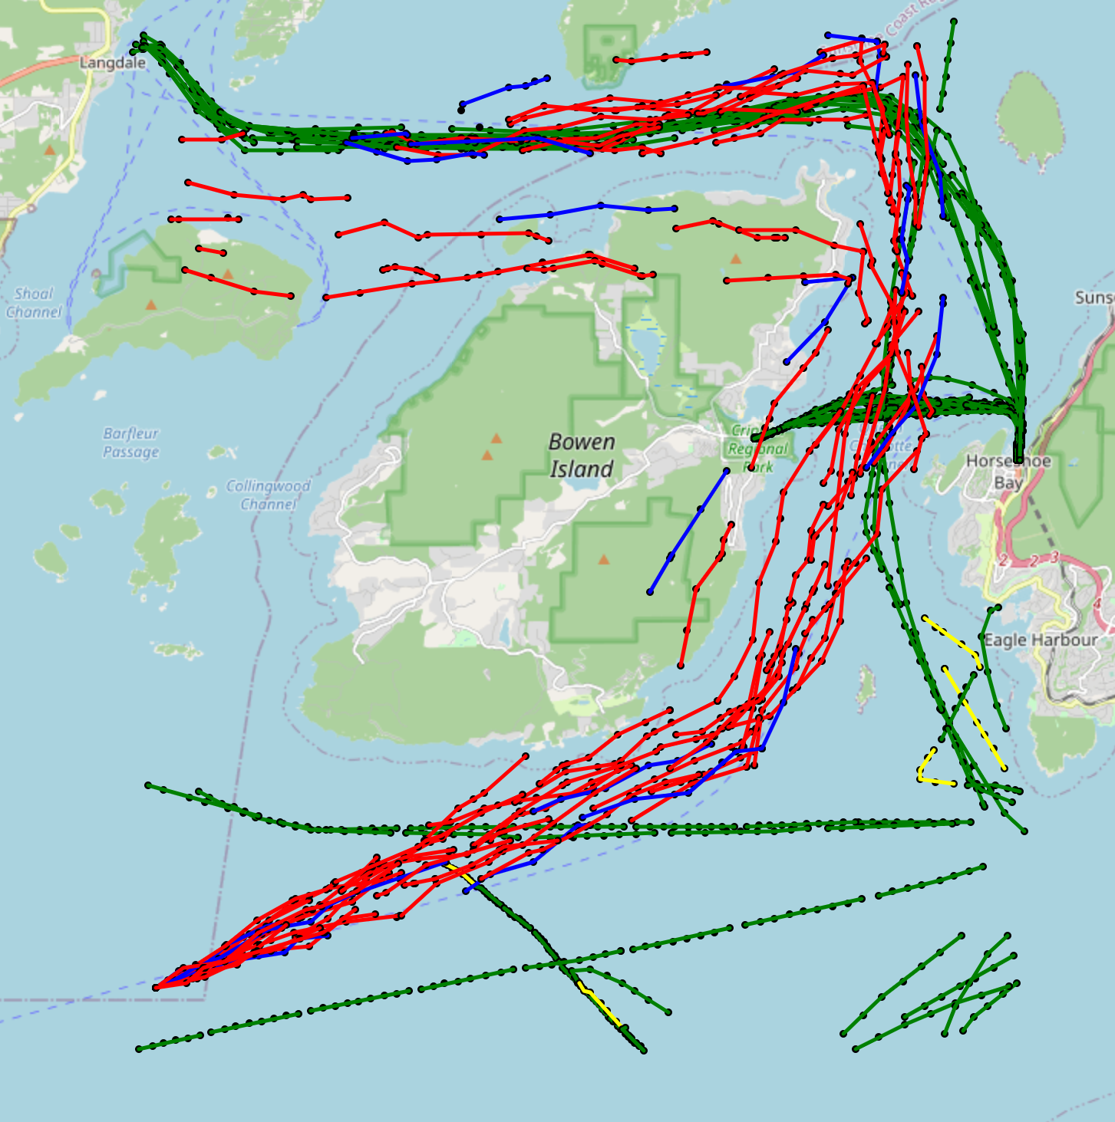
 | False | True
Negative | Red (FN) | Yellow (TN)
Positive | Blue (FP) | Green (TP)
10.2 Map View of results
Result 5
Result 6

Slide 16
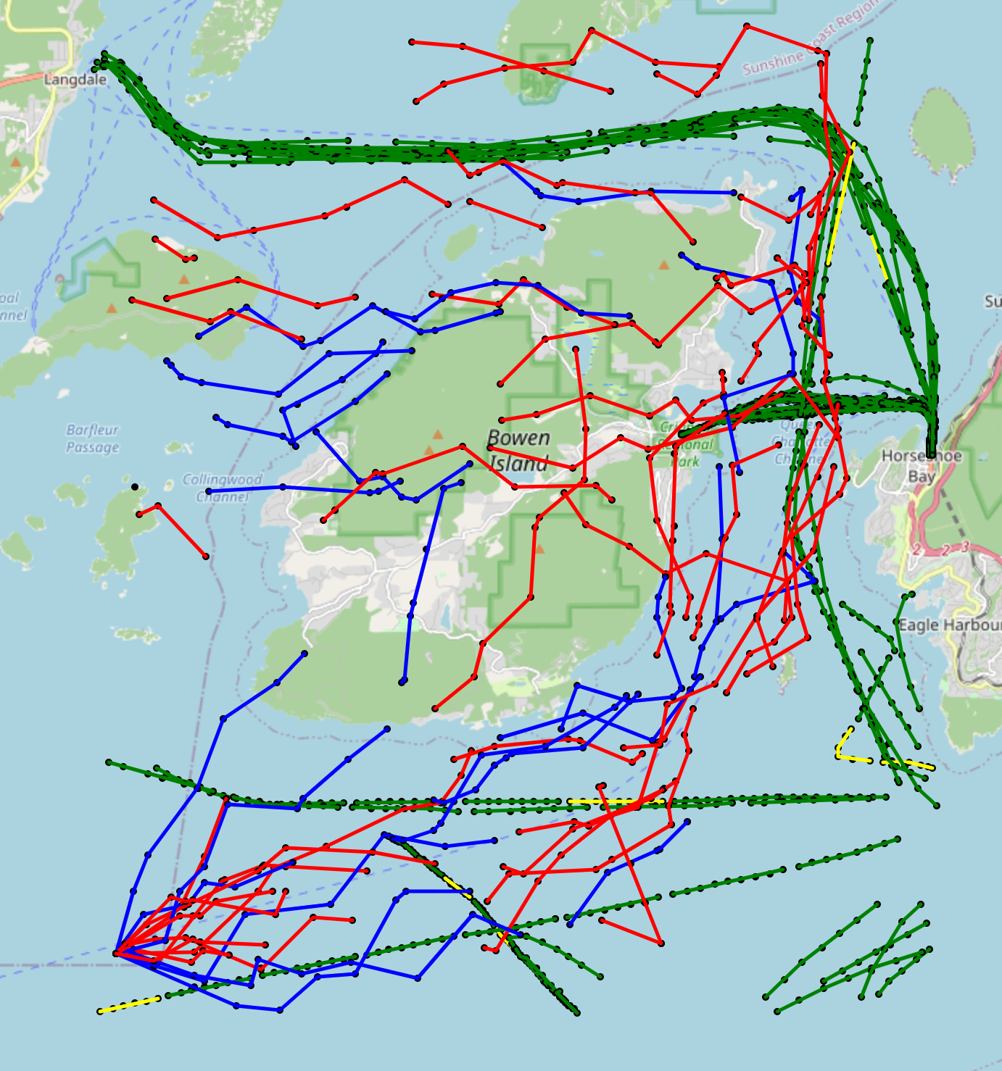
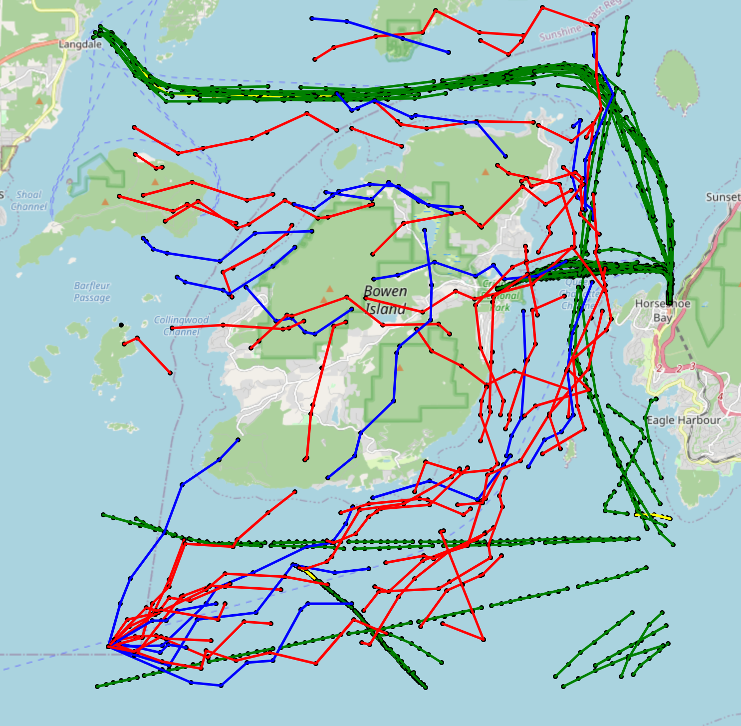
10.2 Map View of results
Result 7
Result 8

Slide 17
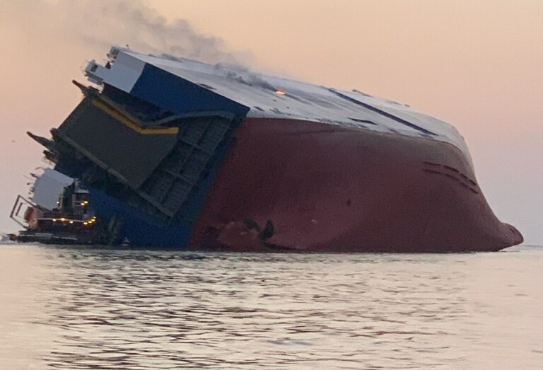
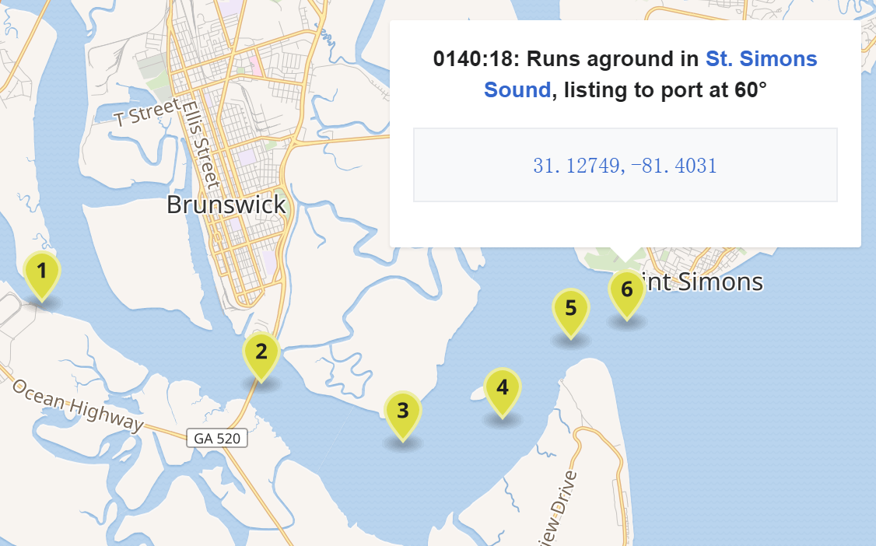
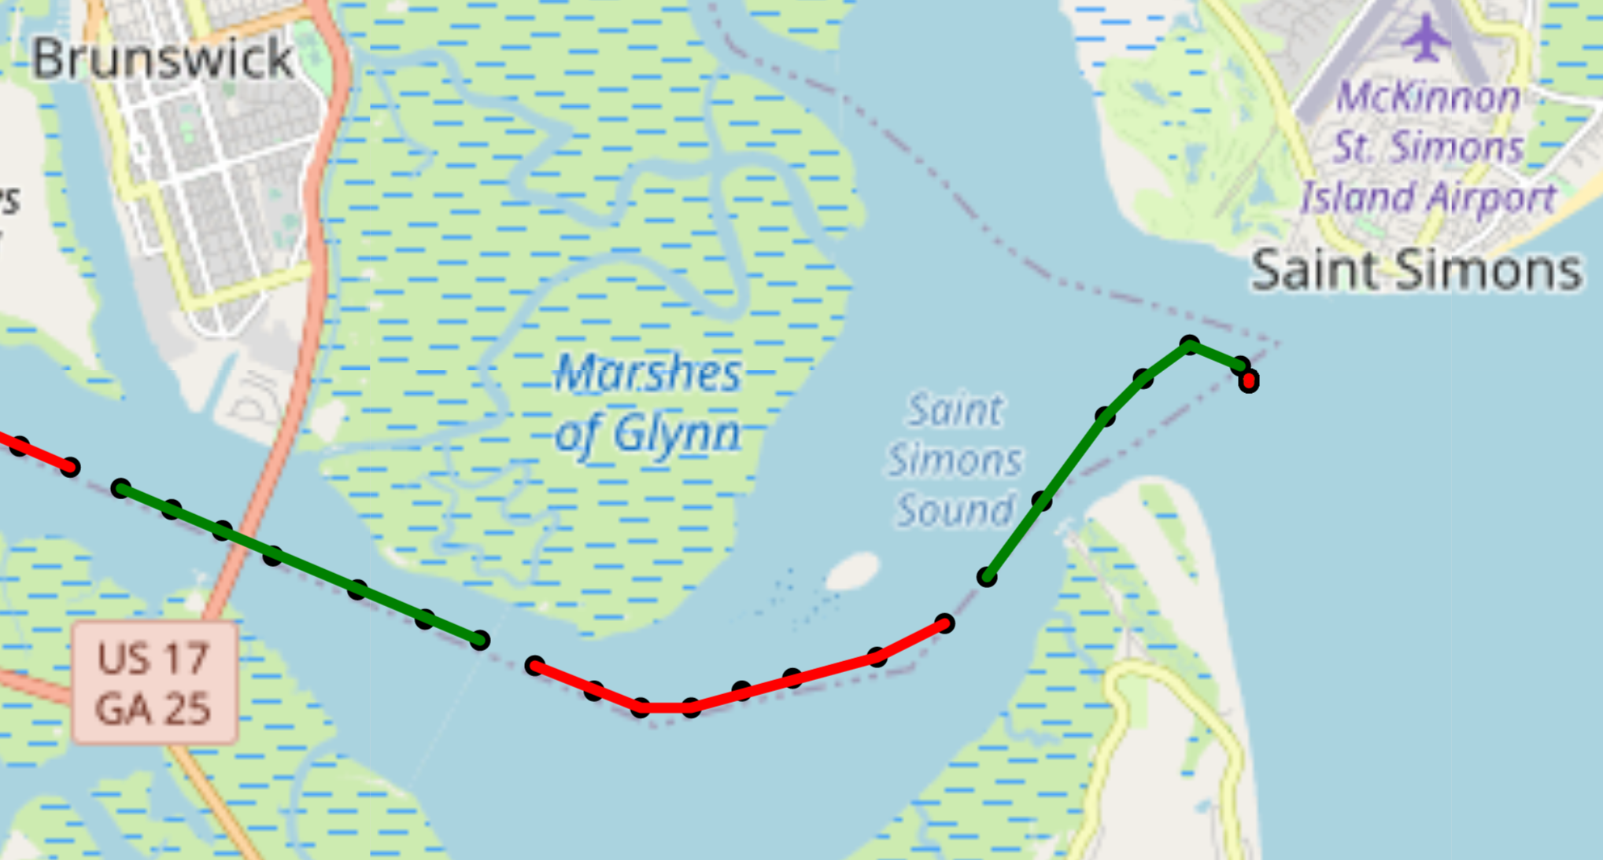
11. Real accident test
11.1 Real accident description：The MV Golden Ray was a 200-metre long (660 ft) roll-on/roll-off cargo ship，On 8 September 2019 at approximately 0137 EDT, the Golden Ray capsized within the Port of Brunswick's harbor, shortly after unberthing and proceeding towards the Port of Baltimore.
The colour here is only to distinguish the segments

Slide 18
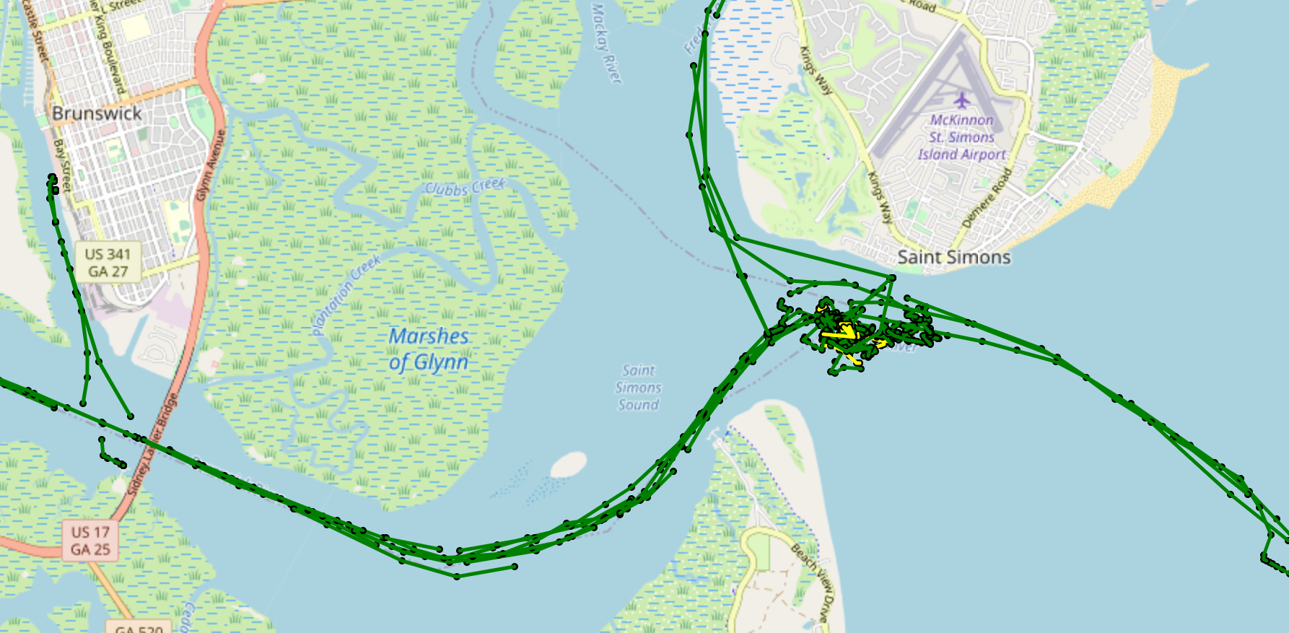
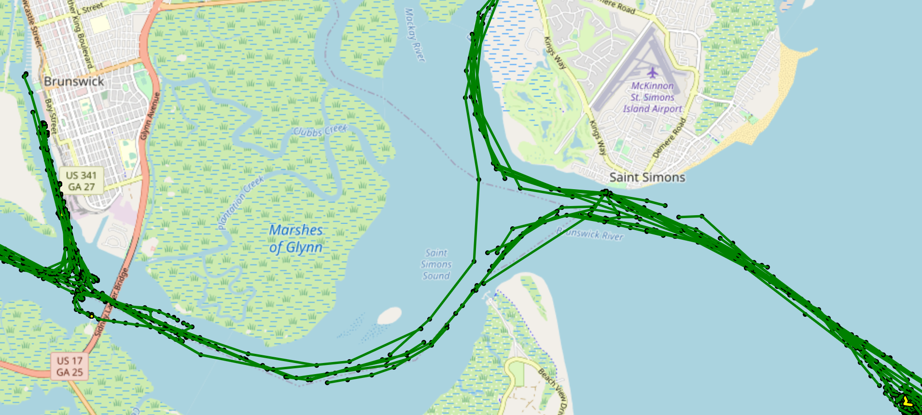
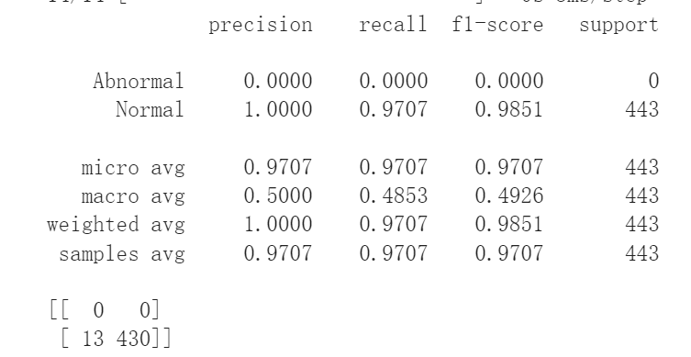
11.2. Performance of the Model Predict
 | Abnormal | Normal
Predict | Yellow | Green
The Day of accident: 08.09.2019
The Day before accident: 07.09.2019

Slide 19
12. Ideas for improvement
Find more realistic anomalous events or artificially set up more anomalous scenarios and simulate anomalous data based on them.
Cut segments in different ways for the same trajectory so that different segment data can be generated for data enhancement.

Slide 20

Q&A

